Slide 1
Arabic Cúram Development Workshop
November, 2013

Slide 2
Agenda
Introduction – who are we?
Overview of the Cúram product – what is Cúram, what does it comprise?
TIVOB – where you will be starting to work.
Development tooling – what tools we use
JIRA and the development process – Task tracking system
Machines/Users - Environment
Building the JDE and running the test application – getting started!

Slide 3
Introduction
Who are we?
Ronan Mulvaney – Lead Architect within Technical Infrastructure
Elaine Mahon – Globalisation & PE/SVT Manager
Padraig Kiely – Lead Architect for Client development
Joseph McAndrew – Technical Product Manager for Technical Infrastructure

Slide 4
Cúram Overview
Commercial-Off-The-Shelf (COTS) business application suite
Designed for social enterprises such as human services, labour, health, social security, workers compensation and veteran’s affairs
Cúram enables agencies to flexibly implement, and maintain agile solutions that are responsive to citizens’ needs and lower operating costs

Slide 5
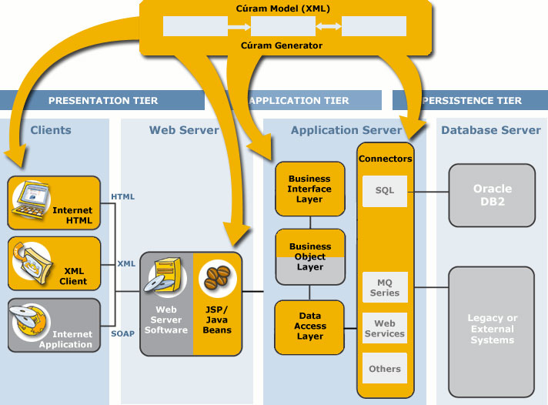
Cúram Architecture Overview

Slide 6
Development Architecture Overview
UML-based application model
Code generators that produce significant portions of client/server applications
Simplified coding of handcrafted business logic
Simplified development of user interface screen
Provides high-level business infrastructure
Mask technology complexities

Slide 7
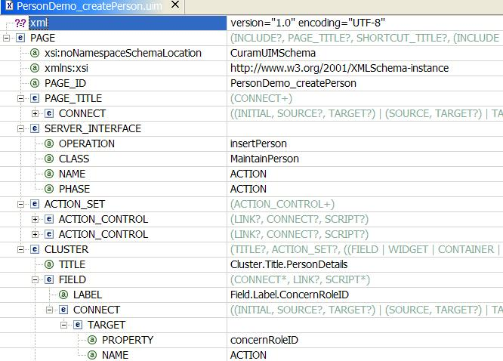
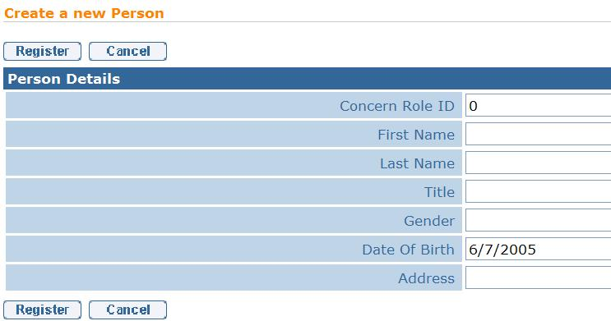
Client Development
Developers create presentation layer independent XML screen definitions
Generators turn them into JSPs
CSS used to control the look and feel
JavaScript can be used to provide richer client functionality

Slide 8
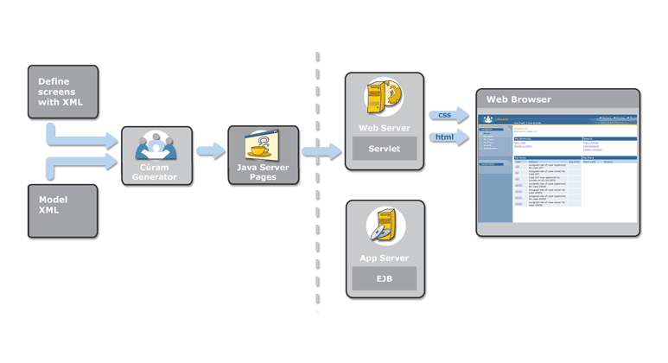
Client Code Generation

Slide 9
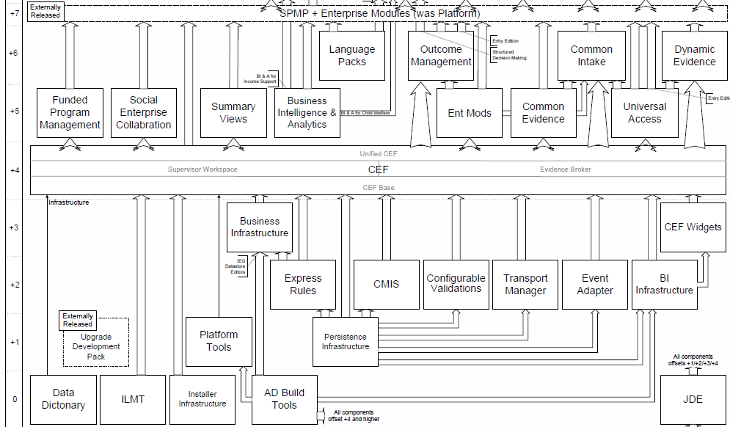
Product Structure - developed in layers

Slide 10
JDE (Java Development Environment)
This part of the product is at the lowest level in the release diagram and provides the infrastructure tooling and libraries on which the business application is built.
It forms two deliveries:
  CuramSDEJ – Server Development Environment for Java
  CuramCDEJ – Client Development Environment for Java
It is developed in a single ClearCase repository TIVOB

Slide 11
TIVOB source structure
appinf – Server-side application model and business process
build_scripts – internal Ant scripts that build the CuramSDEJ and CDEJ
client – Main client-side infrastructure and tooling
commons – Code that is common/shared between the CuramSDEJ and CDEJ
coreinf – Main server-side infrastructure and tooling
devenv – Third-party tooling used to develop in the TIVOB, sourced from network share
lib – third-party libraries both released with CuramSDEJ and CDEJ and used internally
non_source – external server-side Ant scripts, deployment descriptors, etc
tests – various test projects used to test the built CuramSDEJ and CDEJ features

Slide 12
Development Tooling
The products used to develop within the TIVOB are:
  Ant for building/scripting support
  Eclipse for Java, JavaScript, etc
  Tomcat for Client container
  Notepad++ or Eclipse for XML development
  ClearCase, ClearQuest (UCM) for Source Control
  H2 for database/persistence
  IE10 for Browser
  JIRA for Bug/Task tracking

Slide 13
JIRA
JIRA is the defect/task tracking system used within Cúram.
It allows categorisation by Projects and we will be using the Group 1 Languages project for all tickets for this project.
The development process begins with JIRA and either creation or assignment/acceptance of a JIRA ticket.
JIRA can be found at http://pdappsrv:8080/browse/GLS
Your user names are your Cúram id in all lower case letters e.g.:
- Mohamed.ElKhouly becomes mohamed.elkhouly
Your password should have been sent to you during last week.

Slide 14
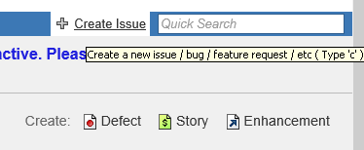
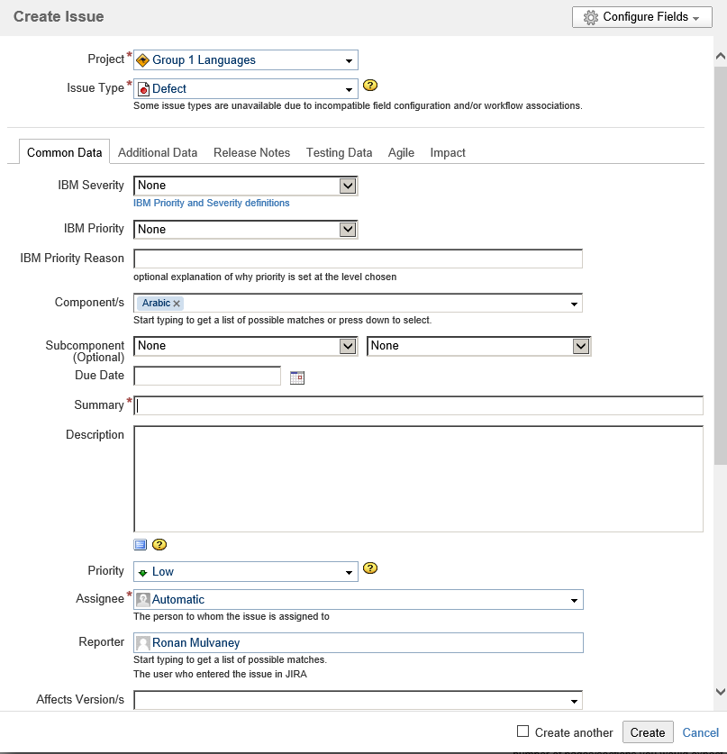
Creating a JIRA ticket
The top right hand corner has the options for creating a JIRA ticket
Opens a larger dialog box where the ticket details are filled in.
Ensure:
  Project = GLS
  Issue Type = Defect
  IBM Severity = Sev 3
  IBM Priority = Normal
  Component = Arabic
  Mandatory Field are completed e.g. Summary, Description, Assignee

Slide 15
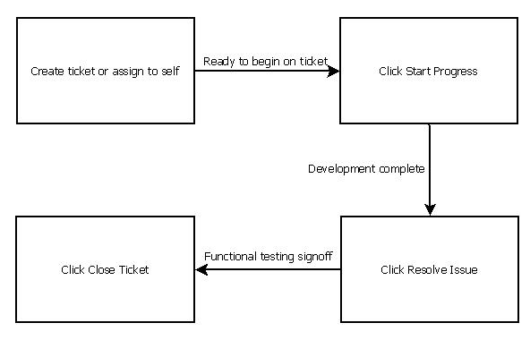
JIRA Workflow

Slide 16
JIRA Demo
Quick look around

Slide 17
Development Process begins
The JIRA ticket is created/assigned to a developer.
Using the detail either in the JIRA ticket or analysis of the codebase, the appropriate change is determined.
The code is then checked out in ClearCase and a new ClearQuest UCM activity created.
This activity title should be the summary of the JIRA ticket and link to the JIRA ticket:
  The JIRA tab on the ClearQuest activity should have the ticket number entered
  The ClearQuest ID on the JIRA ticket should have the ID filled in.

Slide 18
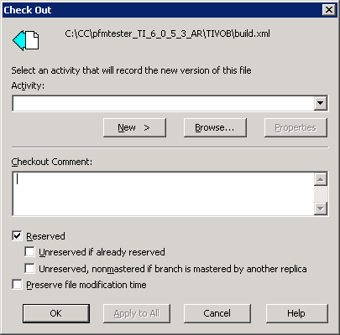
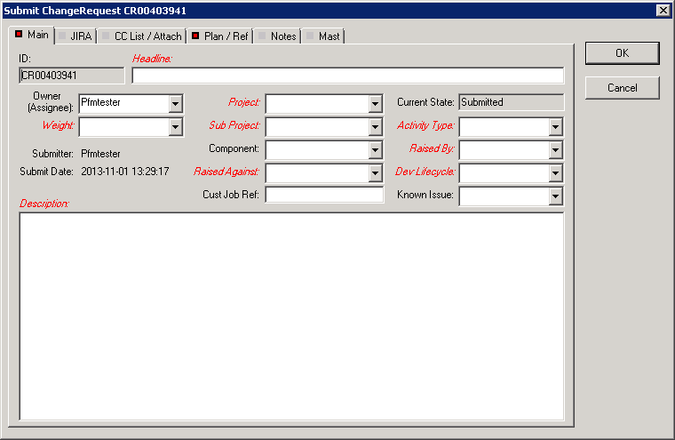
ClearQuest – creating a new Activity

Slide 19
Developing
We pride ourselves in Cúram, especially in the TIVOB, of having well written code.
Achieved through policing tools & standards:
  CheckStyle – we police the code with CheckStyle, any issues should be visible as markers in Eclipse
  Eclipse – we also use Eclipse’s own code policing, so again clean code!
  DocCheck – we police JavaDoc for compliance and expect the change well documented, this is going to of course make any hand over much simpler to do
  Comments – not policed but expectation would be that code is commented appropriately
  Copyright notices – the same content as other files of the same type should be used with the notable expectation being the year
Once the appropriate code change is made, the code is checked in.
Upon task completion the ClearQuest activity should then be Submitted for Development.

Slide 20
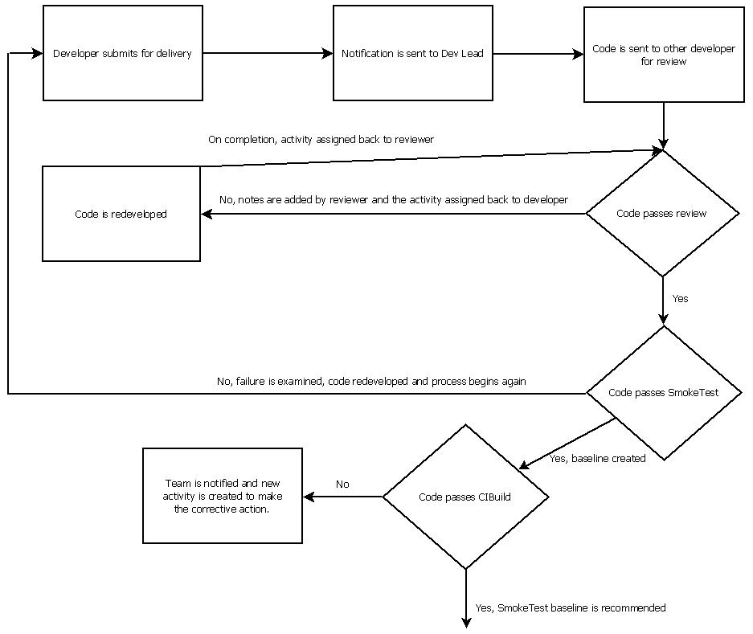
ClearCase/ClearQuest UCM / Process

Slide 21
Machines/Users
We have allocated and set up a number of VMs (8) for you to begin development on. These are:
  dubglbn7-14
You should have already been provided detail on steps to get access to the Dublin BSO.
The user to log into the machines however is a single user which will be used by all.
  This was done to have the machines prepared and initial development codebases setup for you. May change over time.
This user/password is:
  Pfmtester/Platf0rm6

Slide 22
Machine Setup Demo
Quick look around the machine setup

Slide 23
Building the JDE
The root of the TIVOB contains a Windows batch file (build.bat) which is the wrapper script for any Ant target invocation
Building the components of the CuramSDEJ
  build server
Building the components of the CuramCDEJ
  build client
Cleanup before building
  build clean
There is a implied order in that the SDEJ needs to be built to be able to build a CDEJ.
Generally you should just need to build the CDEJ as that is where your work will be focussed however following a rebase it is advised that you build both e.g. build server client

Slide 24
The TabTestApp
With the CuramCDEJ/CuramSDEJ being infrastructure projects it is difficult to visualise or see the affect of changes made.
The TabTestApp (TIVOB\tests\TabTestApp) exists to fill this gap and provides a UI on top of the Client infrastructure features.
The App contains what will be a common structure when we look at further product code repositories:
  EJBServer – All server based code and artefacts
  webclient – All client based code and artefacts
To perform the command line build (following build of the CDEJ/SDEJ):
  build tabtestapp tabtestdatabase

Slide 25
TabTestApp in Eclipse
The Tab test projects are:
  TabTestClient
  TabTestServer
The server runs as a RMI application and is started via the class StartServer in the TabTestServer project.
  This should be run before the Client.
The Client is a Tomcat project and can be run by starting Tomcat via the Tomcat icons or Menu options.
The TabTest app will then be available at http://localhost:9080/TabTest/AppController.do

Slide 26
TabTest Demo
Just a quick look at starting the TabTest App within Eclipse

Slide 27
Tomorrow
Overview of the UI
Client development
Deeper dive into the Client projects within the TIVOB
Development plan walkthrough

Slide 28
Thank you

